Slide 1
Differential Coordinates and Laplacians
Nicholas Vining
Technical Director, Gaslamp Games

Slide 2
Agenda
Differential Coordinates
Laplacian Mesh Operator
A Few Words on Least-Squares Methods
Applications

Slide 3
Do you ever need to:
Connect pieces of geometry together in a complicated way?
Blend geometry together?
Deform geometry to conform to points?
Just work with geometry, full stop?

Slide 4
Cartesian Coordinates
Each point is expressed as a triple:
(x,y,z)
Good for “this is absolutely where things are”
BAD for “this is where a vertex is, in respect to other vertices”

Slide 5
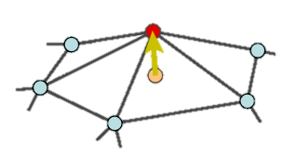
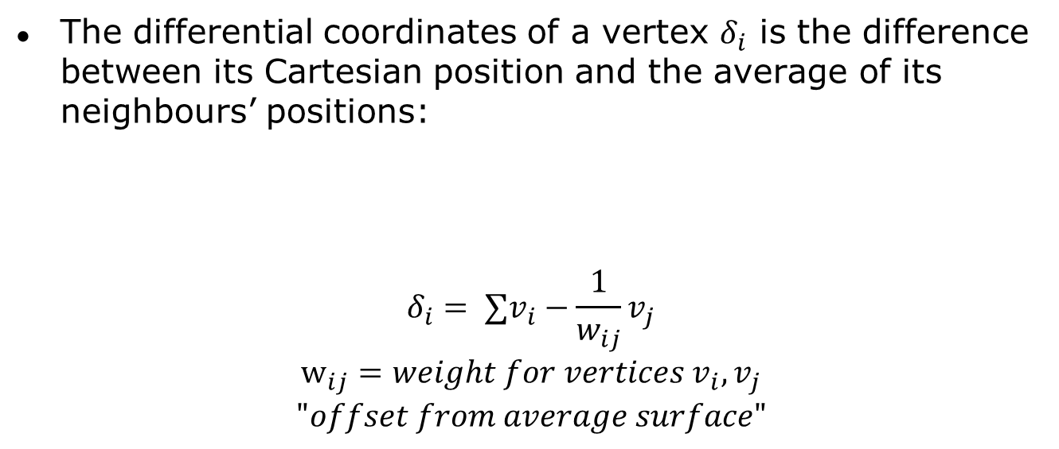
Differential Coordinates
The differential coordinates of a vertex $δ_{i}$ is the difference between its Cartesian position and the average of its neighbours’ positions:
$$δ_{i}= ∑v_{i}−\frac{1}{w_{ij}}v_{j} \\ w_{ij}=weight for vertices v_{i},v_{j} \\ "offset from average surface"$$

Slide 6
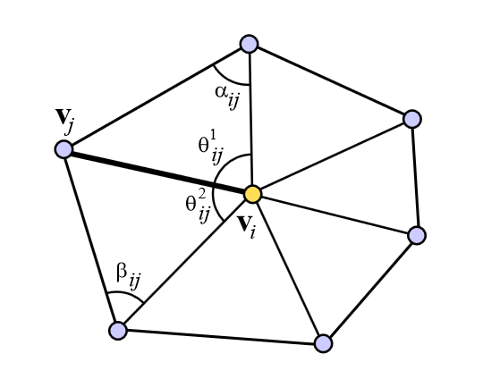
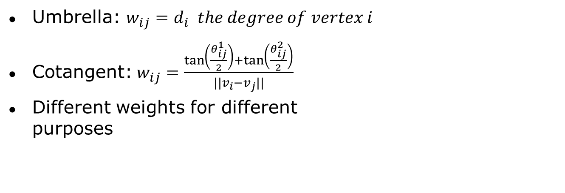
Common Weighting Schemes
Umbrella: $w_{ij}=d_{i} the degree of vertex i$
Cotangent:$w_{ij}=\frac{\tan\left(\frac{θ_{ij}^{1}}{2}\right)+\tan\left(\frac{θ_{ij}^{2}}{2}\right)}{||v_{i}−v_{j}||}$
Different weights for different
purposes

Slide 7

Observations
$δ_{i}$ approximates the local shape of a surface at a point: normal direction, and mean curvature

Slide 8
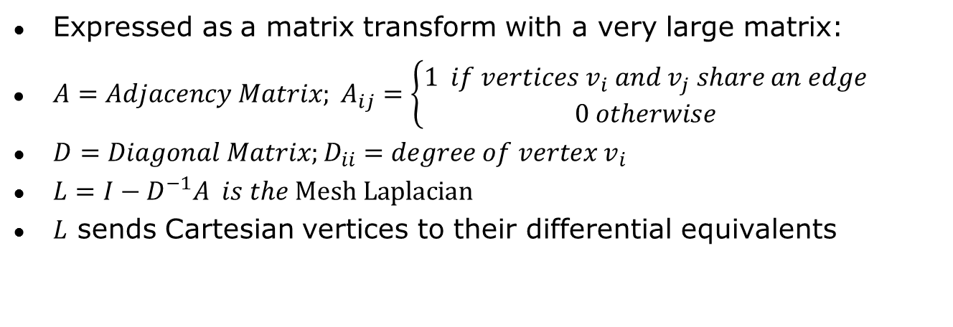
Converting to Differential Coordinates
Expressed as a matrix transform with a very large matrix:
${A=Adjacency Matrix; A}_{ij}=\left\{\begin{aligned}1 if vertices v_{i} and v_{j} share an edge \\ 0 otherwise\end{aligned}\right.$
$D=Diagonal Matrix;D_{ii}=degree of vertex v_{i}$
$L=I−D^{−1}A is the \text{Mesh} \text{Laplacian}$
$L$ sends Cartesian vertices to their differential equivalents

Slide 9

Can we convert back from $δ_{i}$to $v_{i}$?
Nope.
  L is a singular matrix, so its inverse is undefined
  Must supply an “anchor vertex” for each mesh component
    This removes “translational freedom”

Slide 10
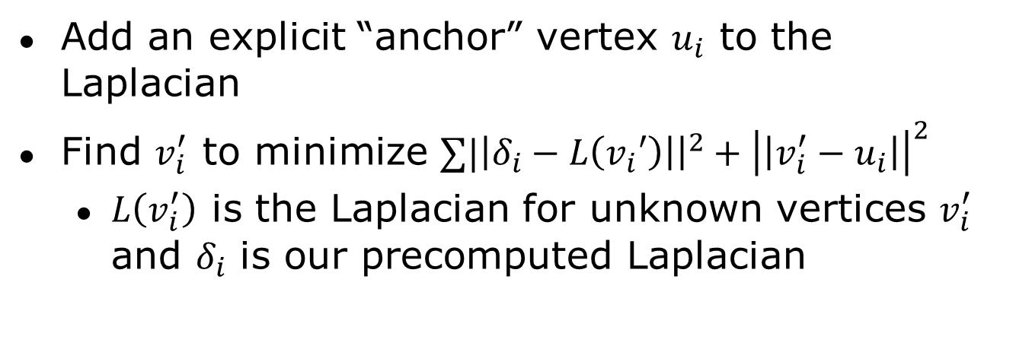
Least Squares to the Rescue
Add an explicit “anchor” vertex $u_{i}$ to the Laplacian
Find $v_{i}^{′}$ to minimize $∑|\left|δ_{i}−L\left(v_{i}′\right)\right|{\left.​\right|}^{2}+{\left|\left|v_{i}^{′}−u_{i}\right|\right|}^{2}$
  $L\left(v_{i}^{′}\right)$ is the Laplacian for unknown vertices $v_{i}^{′}$ and $δ_{i}$ is our precomputed Laplacian

Slide 11
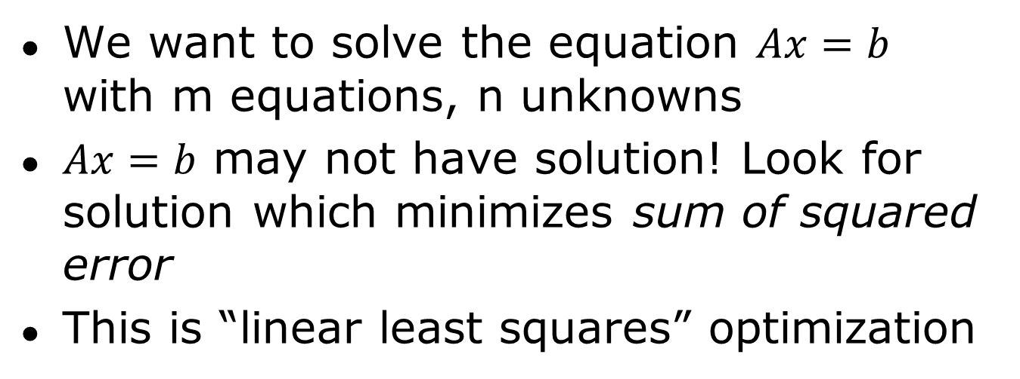
Least-Squares Systems
We want to solve the equation $Ax=b$ with m equations, n unknowns
$Ax=b$ may not have solution! Look for solution which minimizes sum of squared error
This is “linear least squares” optimization

Slide 12
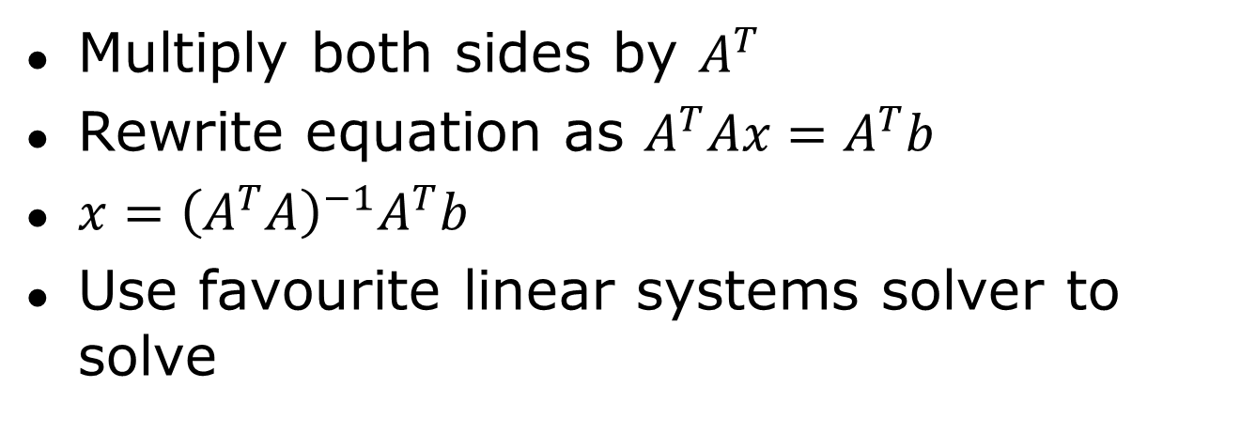
Linear Least Squares
Multiply both sides by $A^{T}$
Rewrite equation as $A^{T}Ax=A^{T}b$
$x={\left(A^{T}A\right)}^{−1}A^{T}b$
Use favourite linear systems solver to solve

Slide 13
So why do I care?
What if we have more than one anchor vertex?
  Least-squares minimization evenly distributes error
  Mesh deforms to incorporate all the “anchors”
  Result: easy framework for solving complex geometrical problems w/deformation!

Slide 14
Advice on Linear Least Systems
DO NOT WRITE YOUR OWN SOLVER
  Just don’t do it. This stuff is HARD TO GET RIGHT
TAUCS, Cholmod are both very good
  License issues?
Be cautious of Eigen…

Slide 15
By the way…
So many problems can be expressed as least squares problems and then solves
Do this
It is one of the few things that Works™ in Geometric Mesh Processing

Slide 16
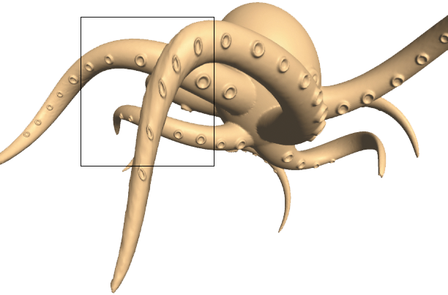
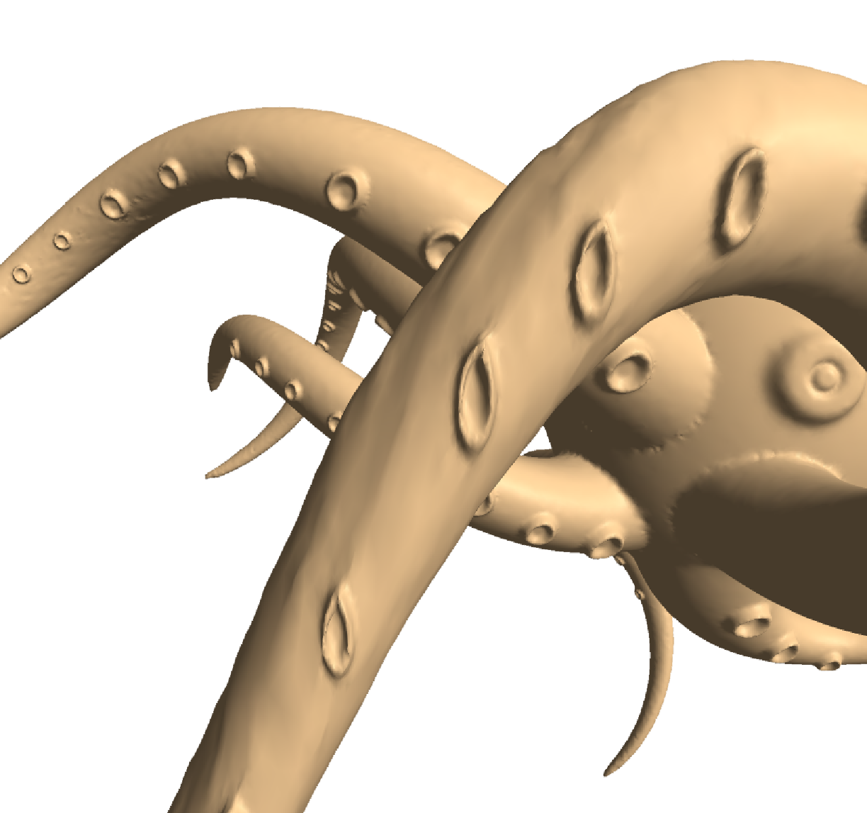
Problem
Laplacian coordinates
are only translation
invariant
Not rotation invariant

Slide 17
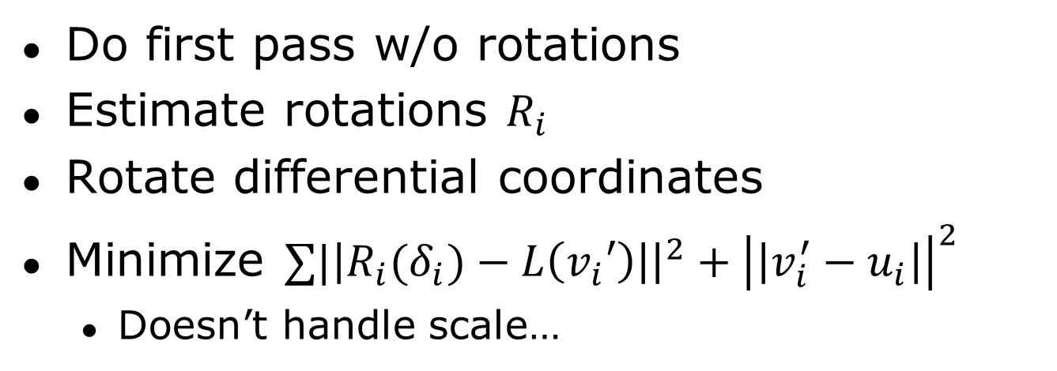
Solution
Do first pass w/o rotations
Estimate rotations $R_{i}$
Rotate differential coordinates
Minimize $∑|\left|R_{i}(δ_{i})−L\left(v_{i}′\right)\right|{\left.​\right|}^{2}+{\left|\left|v_{i}^{′}−u_{i}\right|\right|}^{2}$
  Doesn’t handle scale…

Slide 18
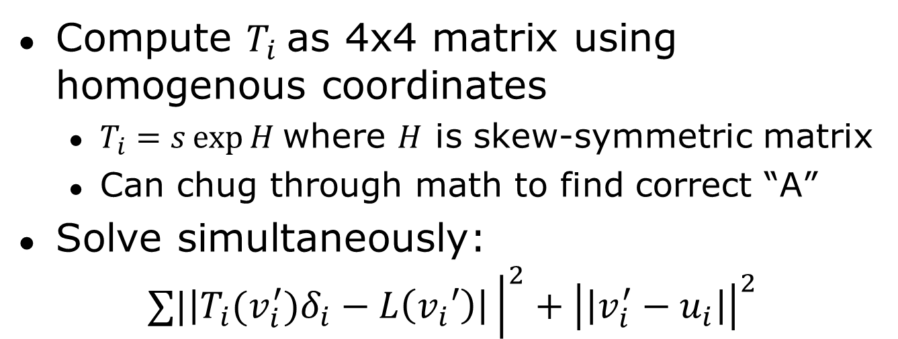
Alternate Solution
Compute $T_{i}$as 4x4 matrix using homogenous coordinates
  $T_{i}=s\exp{H}$where $H$ is skew-symmetric matrix
  Can chug through math to find correct “A”
Solve simultaneously:
$$∑|\left|T_{i}(v_{i}^{′})δ_{i}−L\left(v_{i}′\right)\right|{\left.​\right|}^{2}+{\left|\left|v_{i}^{′}−u_{i}\right|\right|}^{2}$$

Slide 19
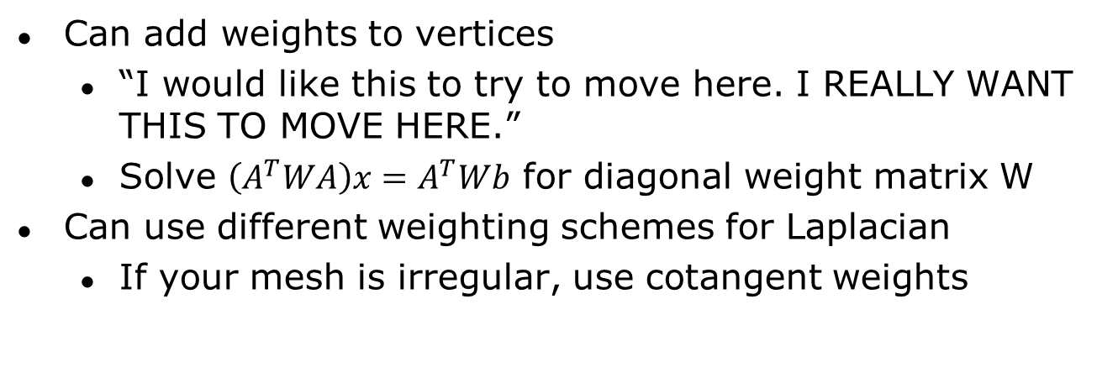
Put Some Weights On It!
Can add weights to vertices
  “I would like this to try to move here. I REALLY WANT THIS TO MOVE HERE.”
  Solve $\left(A^{T}WA\right)x=A^{T}Wb$ for diagonal weight matrix W
Can use different weighting schemes for Laplacian
  If your mesh is irregular, use cotangent weights

Slide 20
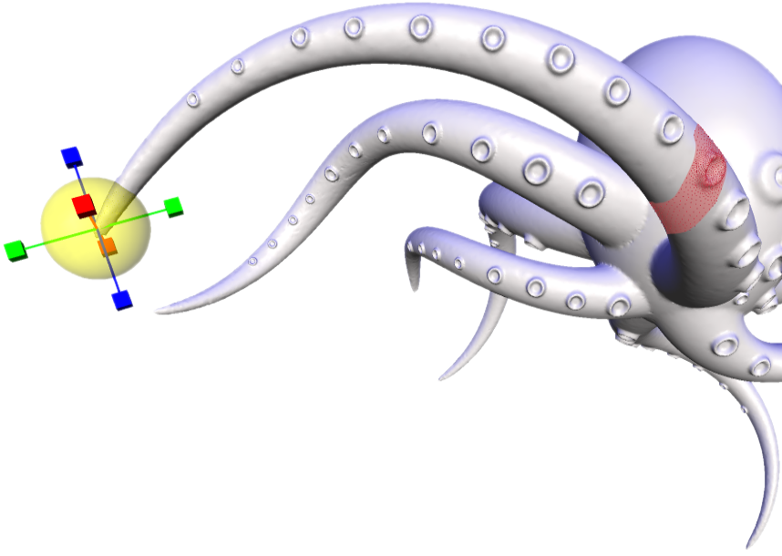
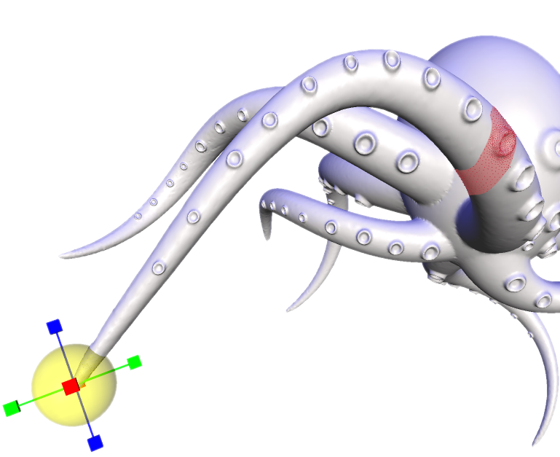
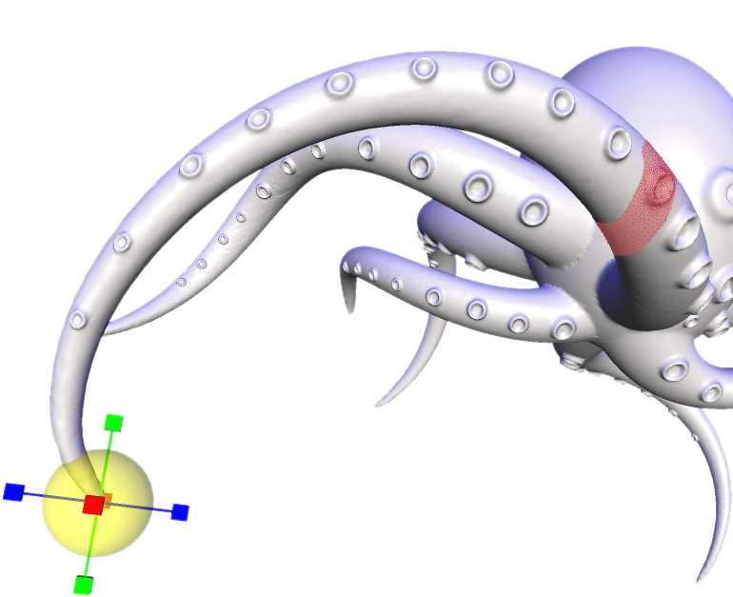
Mesh Editing Examples
(“Laplacian Surface Editing”, Sorkine et al.)

Slide 21
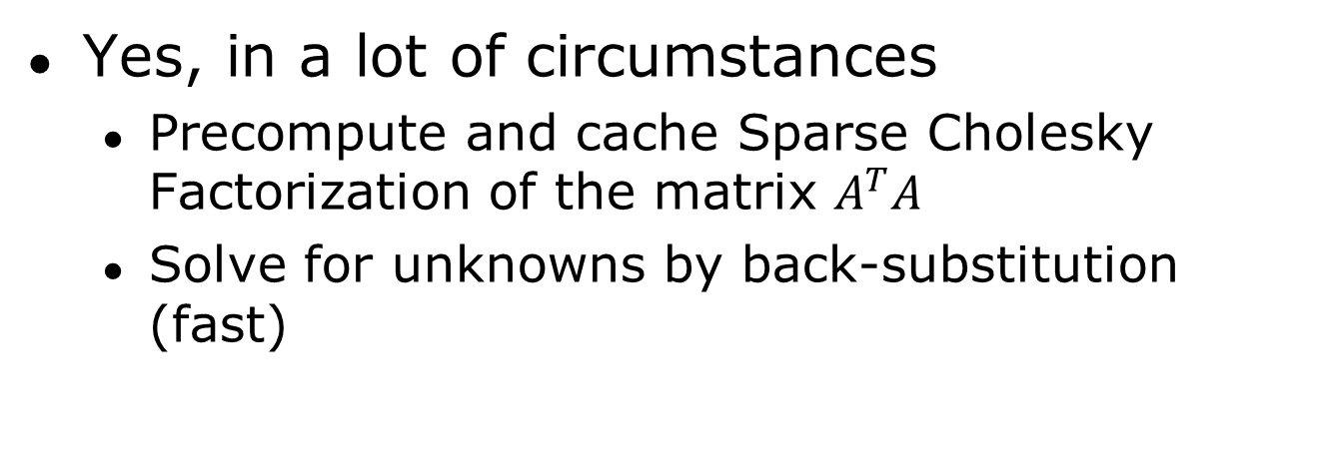
Can You Do This in Real Time?
Yes, in a lot of circumstances
  Precompute and cache Sparse Cholesky Factorization of the matrix $A^{T}A$
  Solve for unknowns by back-substitution (fast)

Slide 22
Applications
Level Geometry (esp. Terrain):
  “I want the thing to face this direction, but to be held in place here”
Procedural Content of All Sorts, Really
  Stitching things together…

Slide 23
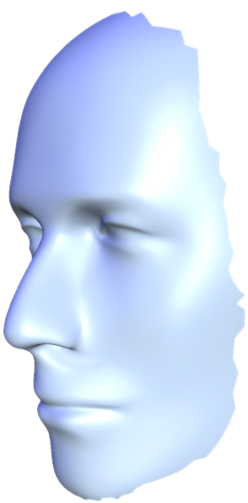
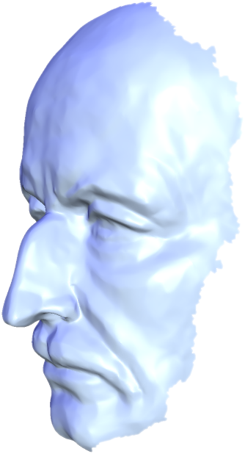
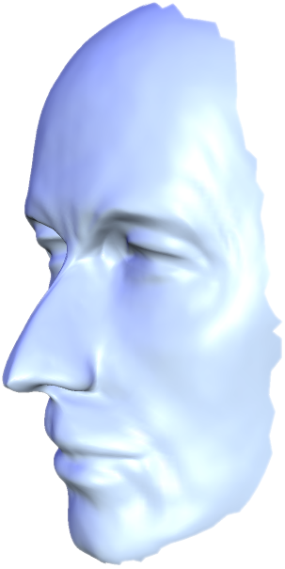
Face Shape Blending/Detail Transfer
(“Laplacian Surface Editing”, Sorkine et al.)

Slide 24
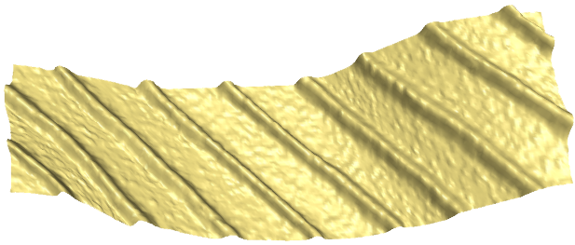
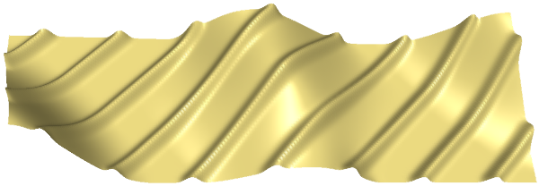
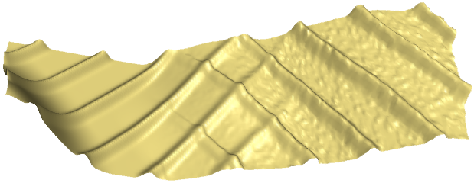
Geometric Detail Transfer

Slide 25
ARAP
Alternative technique if you want “as rigid as possible” deformation
Laplacian
ARAP
(“As-Rigid-As-Possible Surface Modeling”, Sorkine and Alexa)

Slide 26
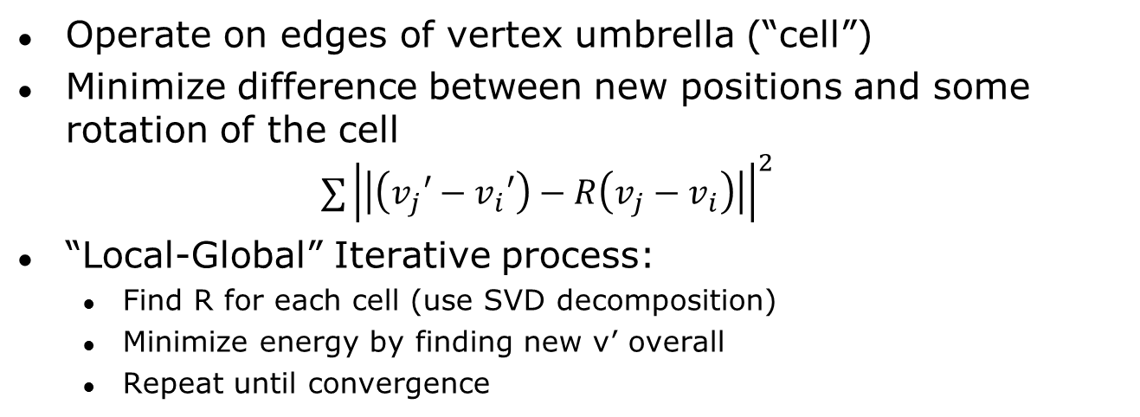
ARAP Idea
Operate on edges of vertex umbrella (“cell”)
Minimize difference between new positions and some rotation of the cell
$∑{\left|\left|\left(v_{j}′−v_{i}′\right)−R\left(v_{j}−v_{i}\right)\right|\right|}^{2}$
“Local-Global” Iterative process:
  Find R for each cell (use SVD decomposition)
  Minimize energy by finding new v’ overall
  Repeat until convergence

Slide 27
Takeaways
Laplacian + friends are very powerful
Least Squares Methods are EXTREMELY powerful
Use this knowledge wisely in your games

Slide 28
Recommended Reading
Y. Lipman et al. “Differential Coordinates for Interactive Mesh Processing”. Proc. SMI 2004
O. Sorkine. “Laplacian Mesh Processing.” Eurographics STAR Report, 2005 (includes many powerful Laplacian secrets!)
O. Sorkine, M. Alexa. “As-Rigid-As-Possible Surface Modeling.” Proc. Eurographics 2007

Slide 29
Thank You For Listening
Questions?
Sample Code will be posted online at some point; watch @nvining on Twitter for more details

